Slide 1
Data binding

Slide 2
Main content
Basic Data binding
Converter
INotifyPropertyChanged
List data binding

Slide 3
Basic Data binding

Slide 4
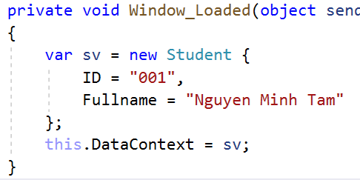
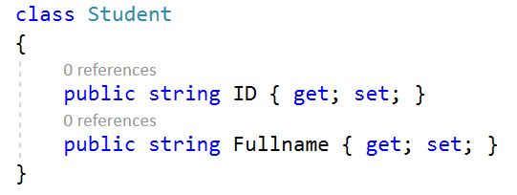


Use DataContext to create connection with the UI

Slide 5
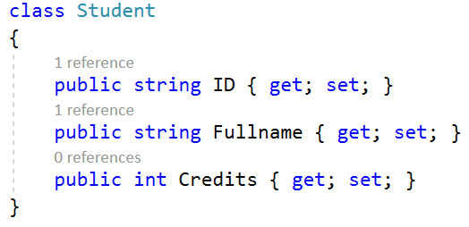
Minor adjustment
Let assume that, to graduate, a student must aggregate 360 credits
Let’s add the current credits information

Slide 6
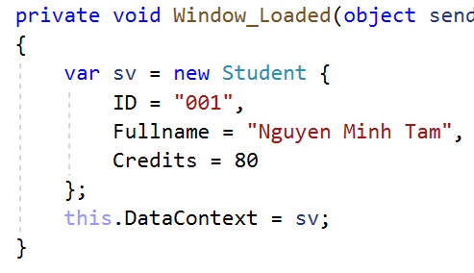

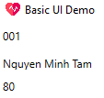
Editing the binding for the added property

Slide 7
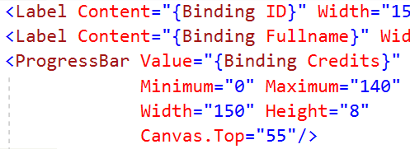
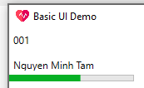
Changing way of displaying - ProgressBar
Better? Percentage? Circle?
https://stackoverflow.com/questions/4871263/how-to-create-a-circular-style-progressbar

Slide 8
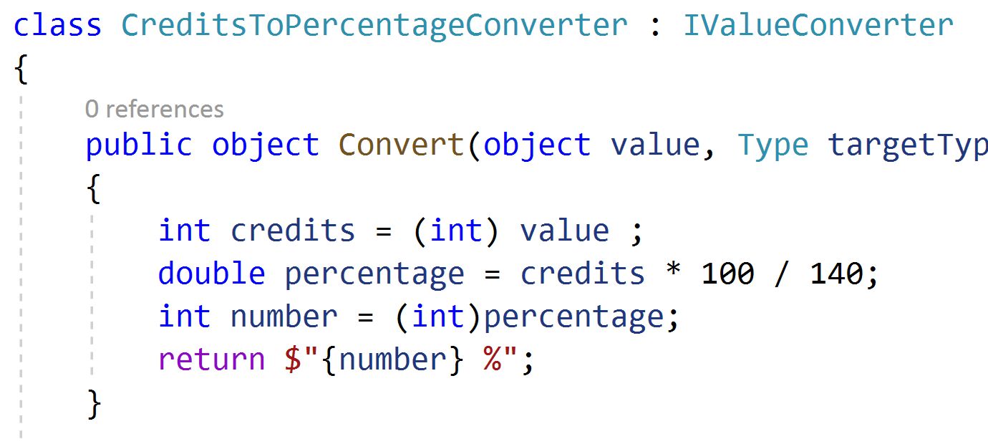
Converter – Step 1
{number: 0.00}: allows two

Slide 9
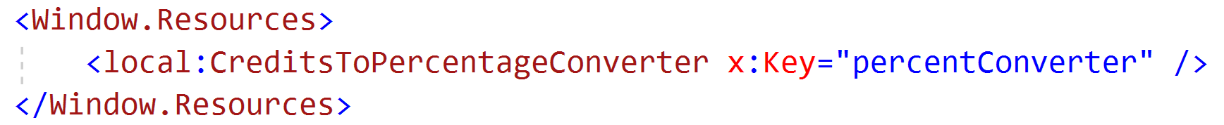
Step 2: Declaration as a resource
The above is equivalent to this:

Slide 10
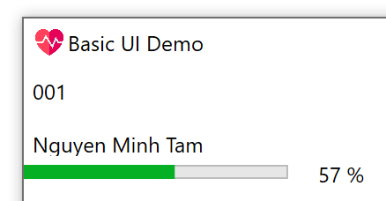
Step 3: Use the Converter

Slide 11
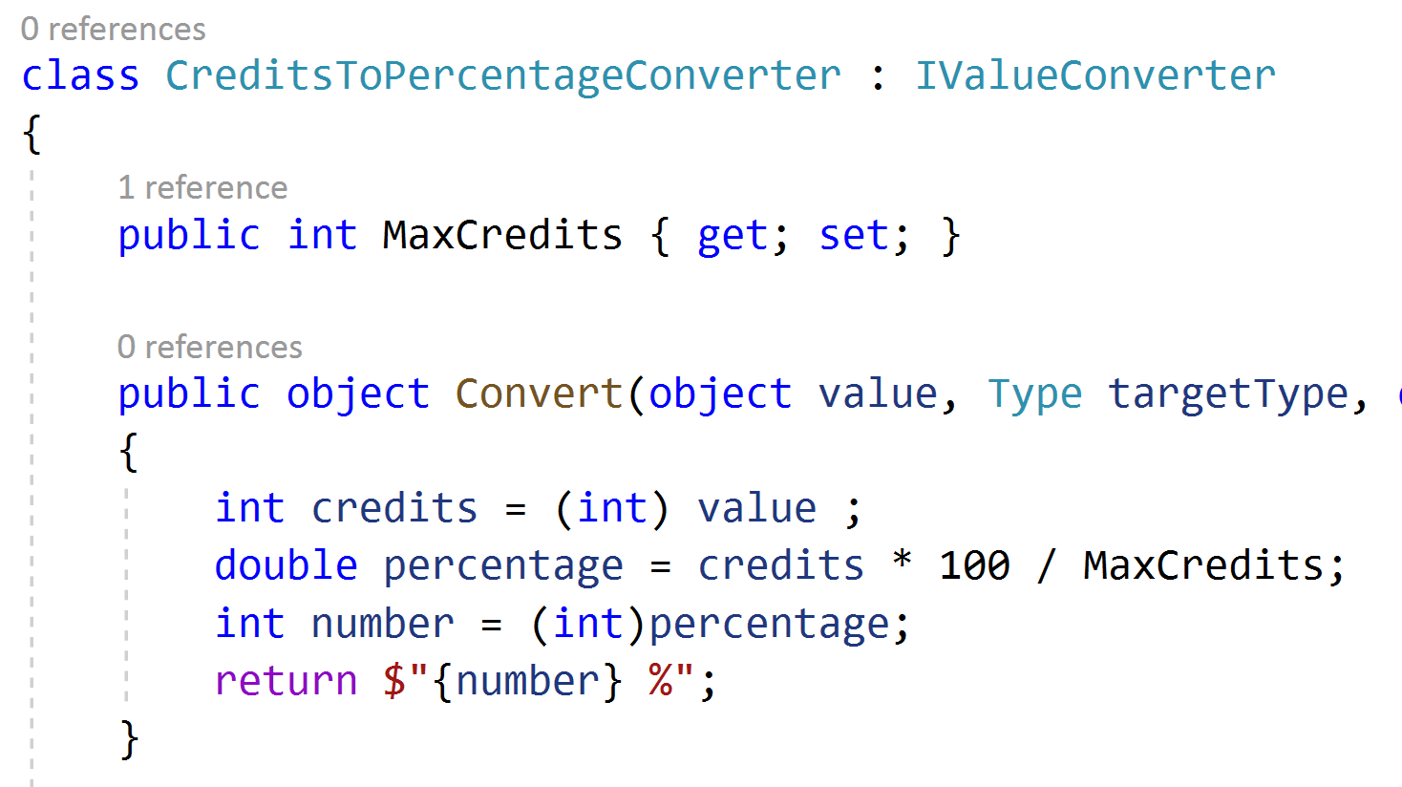
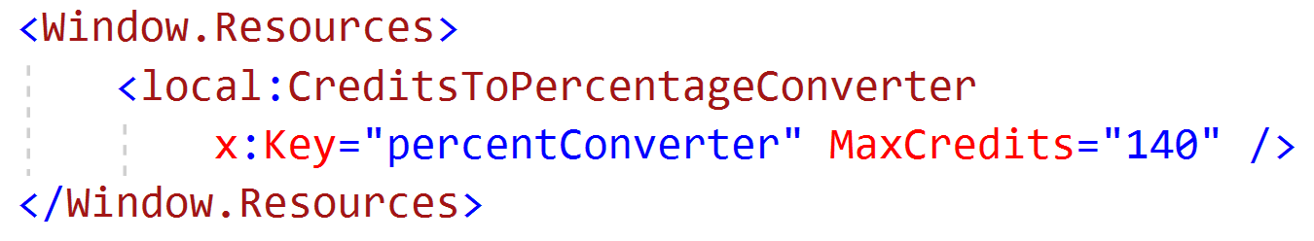
Turn max into parameter

Slide 12
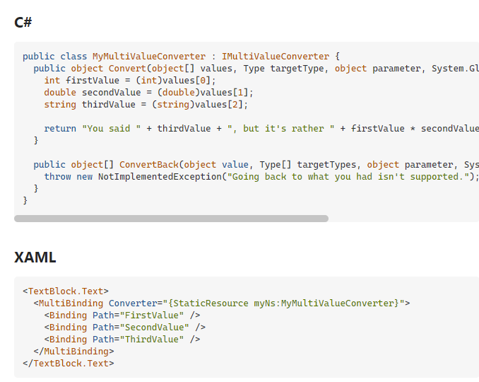
Multi value converter

Slide 13
In-class exercise – Project ConfigLoader
Create a class Config that stores:
Last server
Last username
Create a screen that display that information using data binding

Slide 14
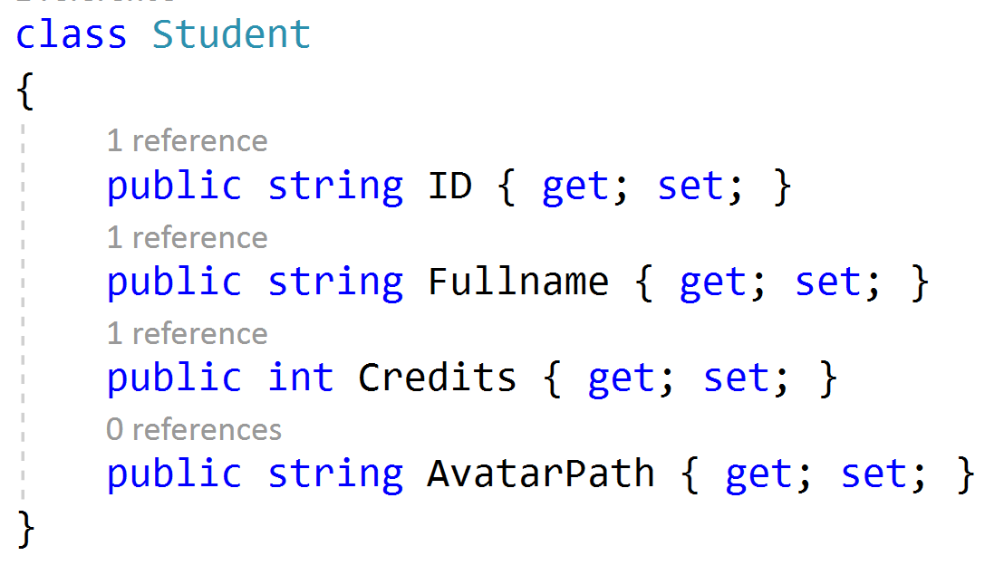
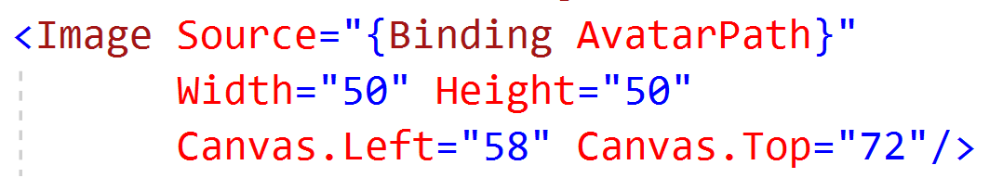
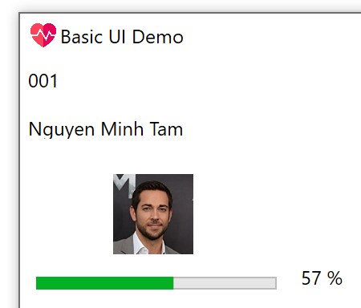
Displaying image using data binding
Using embeded image inside the executable file

Slide 15
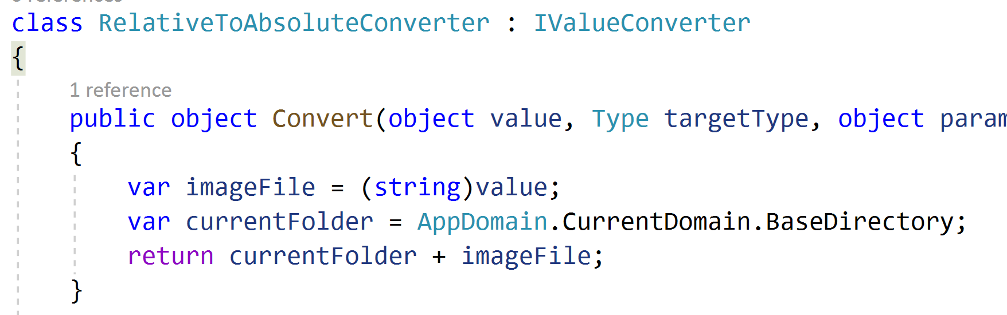
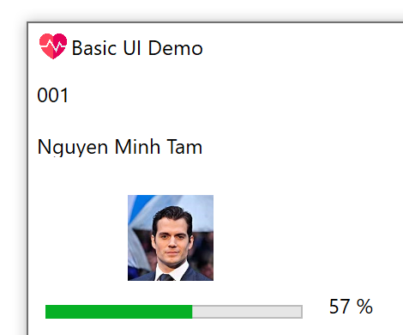
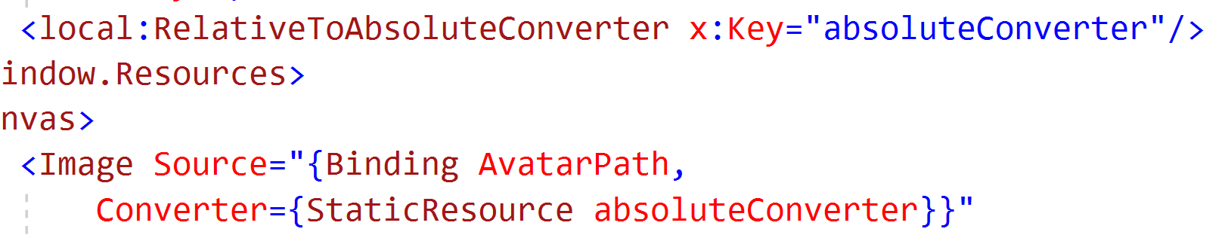
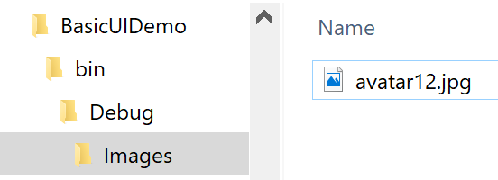
Using absolute path

Slide 16
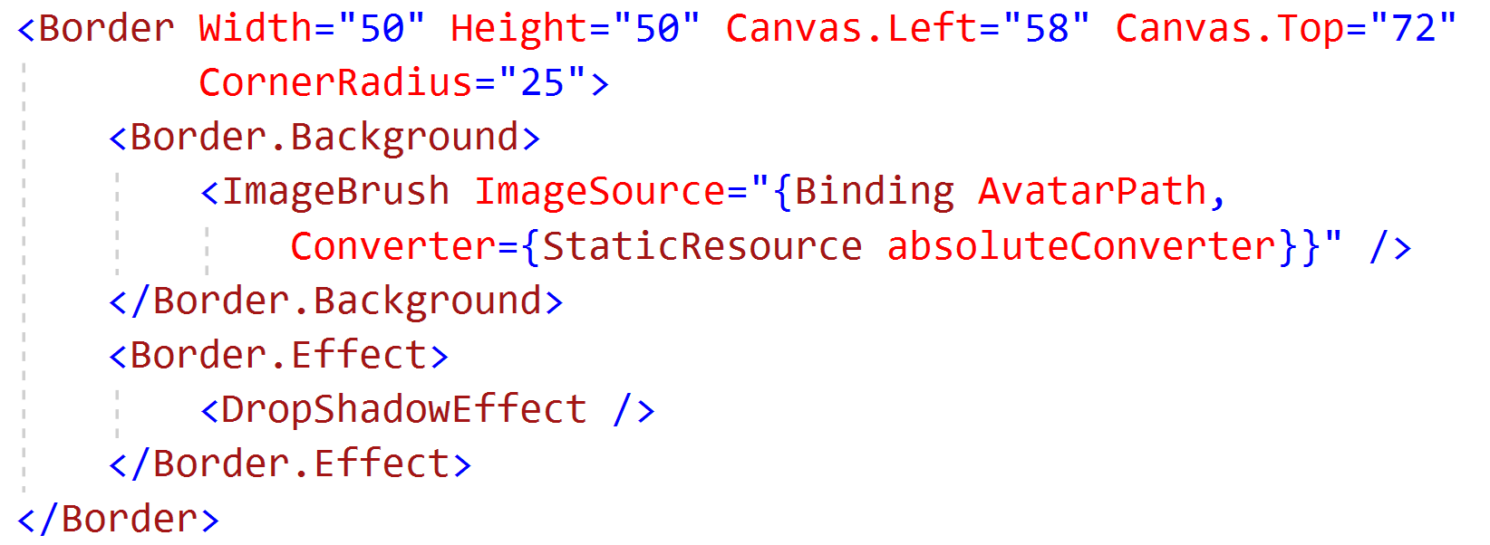

Add rounded corner

Slide 17
UI Synchronization

Slide 18
Core idea
Underlying data change => UI automatically change

Slide 19
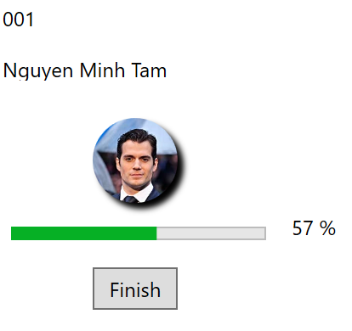
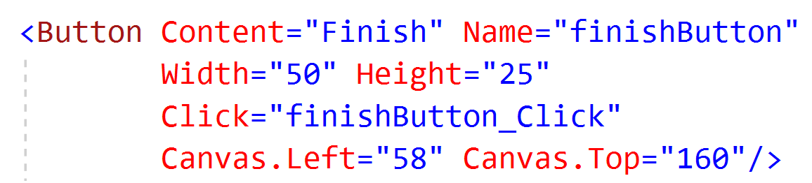
Adding button to update

Slide 20
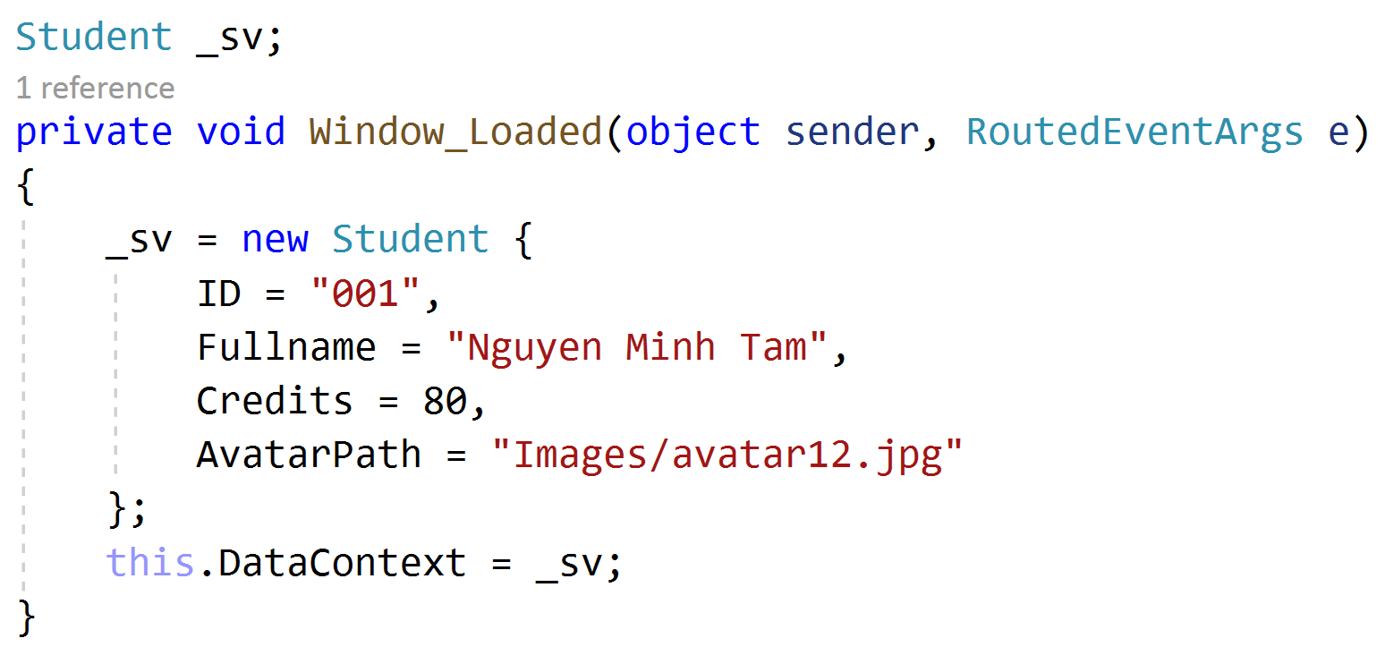

Slide 21
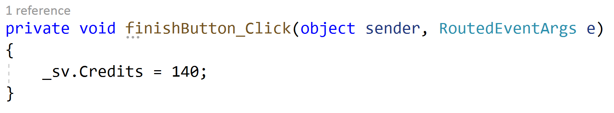
Update the credits when clicked
We see nothing change in the UI! Why?
Need to implement INotifyPropertyChanged

Slide 22
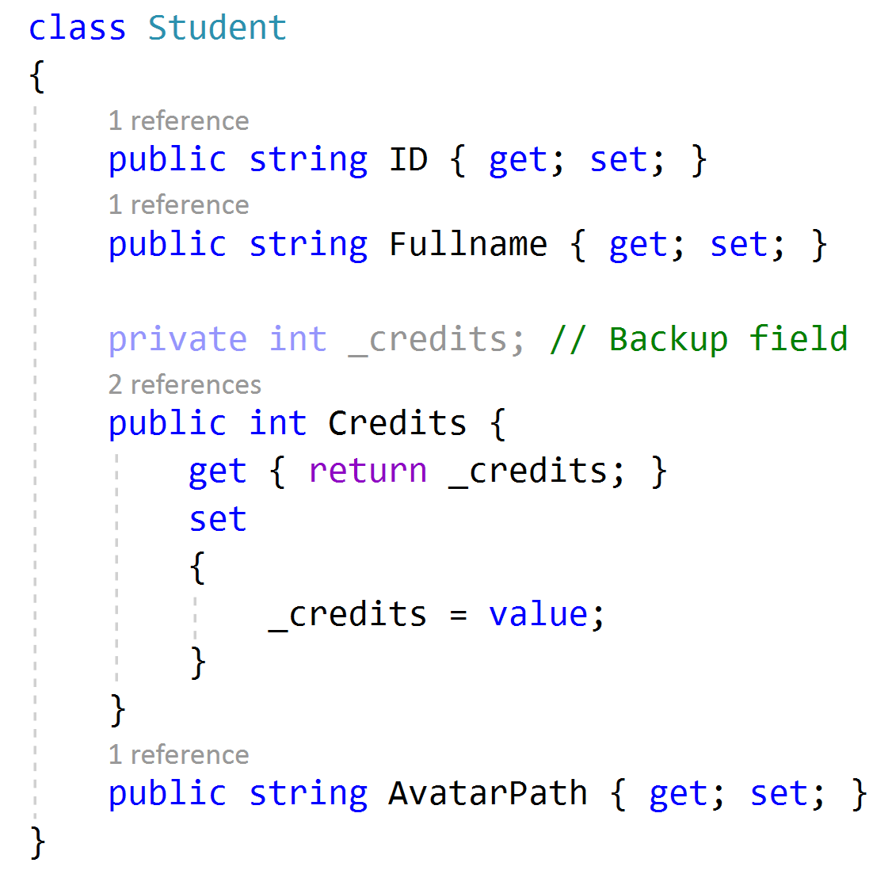
Underlying code of getter and setter

Slide 23
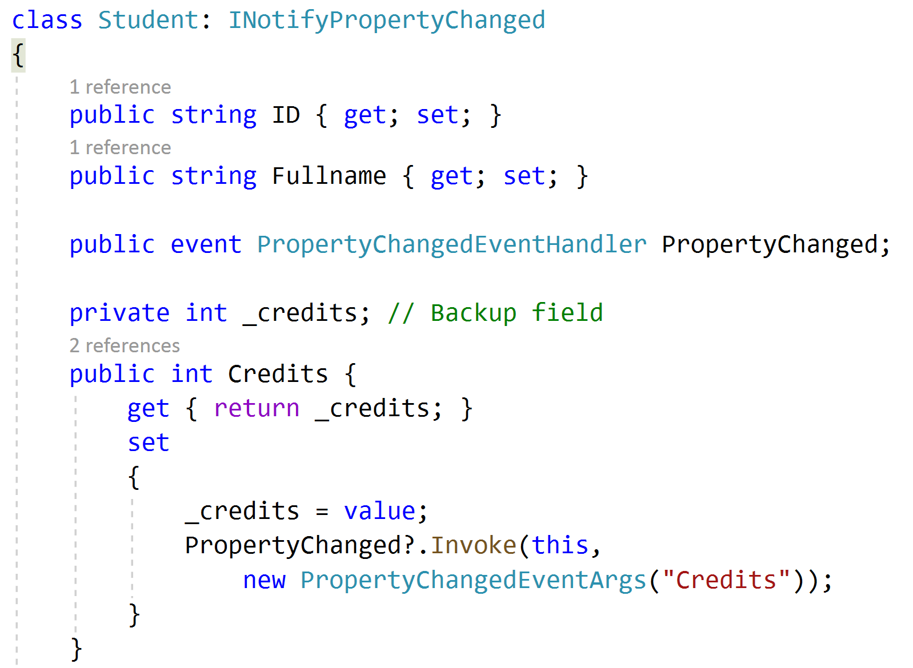
Implementing INotifyPropertyChanged

Slide 24
Tools to use rather than manually writing
Fody.PropertyChanged (Need at least VS 2019)

Slide 25
Homework
Do data binding for a book: Book’s name, Cover’s image, Author, Published Year
Do data binding for a mobile phone: Phone’s name, Image, Manufacturer, Price
Do data binding for an employee: Fullname, Email, Address, Telephone number, Avatar’s image

Slide 26
Binding a list

Slide 27
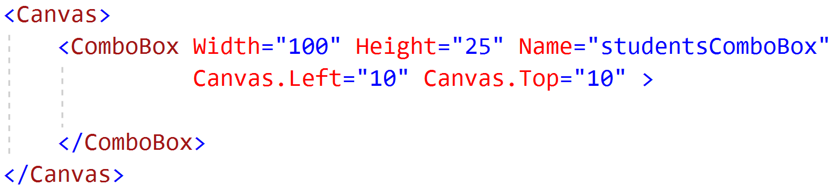
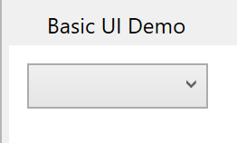
Prepare UI using ComboBox

Slide 28
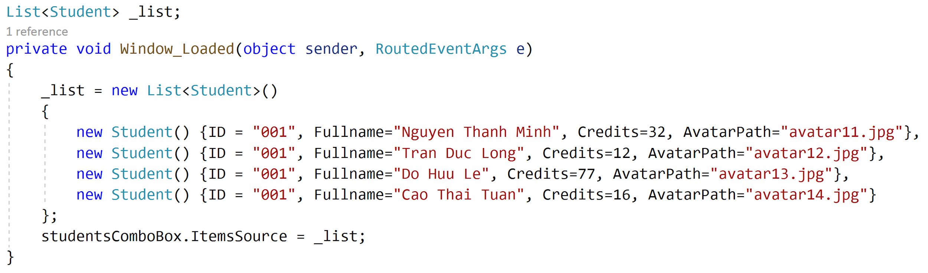
Sample data
Notes:
_students = new ObservableCollection<Student>()
{
new Student() {
ID = "001",
Name="Ngư Thuận Phong",
Avatar="Images/avatar01.jpg"
},
new Student() {
ID = "002",
Name="Mai Việt Hùng",
Avatar="Images/avatar02.jpg"
},
new Student() {
ID = "003",
Name="Thủy Tất Hiếu",
Avatar="Images/avatar03.jpg"
},
new Student() {
ID = "004",
Name="Nguyễn Trí Dũng",
Avatar="Images/avatar04.jpg"
},
new Student() {
ID = "005",
Name="Hồ Hồng Quang",
Avatar="Images/avatar05.jpg"
},
new Student() {
ID = "006",
Name="Vũ Tuấn Hùng",
Avatar="Images/avatar06.jpg"
},
new Student() {
ID = "007",
Name="Nguyễn Việt Cường",
Avatar="Images/avatar07.jpg"
},
new Student() {
ID = "008",
Name="Lâm Thanh Toàn",
Avatar="Images/avatar08.jpg"
},
new Student() {
ID = "009",
Name="Trịnh Việt Nhân",
Avatar="Images/avatar09.jpg"
},
new Student() {
ID = "010",
Name="Bùi Ðức Cường",
Avatar="Images/avatar10.jpg"
},
new Student() {
ID = "011",
Name="Phan Thiện Dũng",
Avatar="Images/avatar11.jpg"
},
new Student() {
ID = "012",
Name="Phan Nhật Quân",
Avatar="Images/avatar12.jpg"
},
new Student() {
ID = "013",
Name="Ngô Việt Dũng",
Avatar="Images/avatar13.jpg"
},
new Student() {
ID = "014",
Name="Hoàng Vinh Quốc",
Avatar="Images/avatar14.jpg"
},
new Student() {
ID = "015",
Name="Đặng Ðức Siêu",
Avatar="Images/avatar15.jpg"
},
new Student() {
ID = "016",
Name="Đàm Thanh Thanh",
Avatar="Images/avatar16.jpg"
},
new Student() {
ID = "017",
Name="Lục Phương Loan",
Avatar="Images/avatar17.jpg"
},
new Student() {
ID = "018",
Name="Uất Như Quỳnh",
Avatar="Images/avatar18.jpg"
},
new Student() {
ID = "019",
Name="Lạc Huyền Trân",
Avatar="Images/avatar19.jpg"
},
new Student() {
ID = "020",
Name="Nguyễn Băng Băng",
Avatar="Images/avatar20.jpg"
}
};

Slide 29
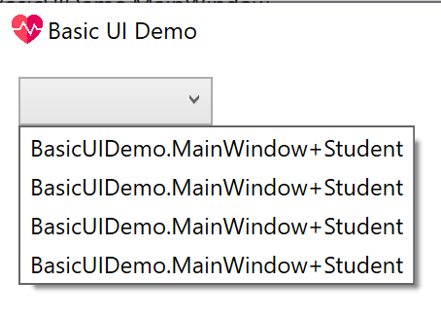
The result

Slide 30
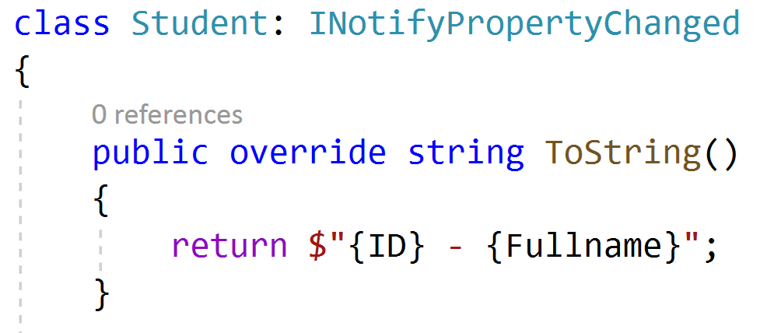
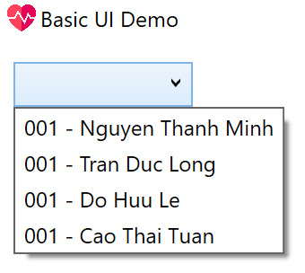
Simple way to modify
But it should not be this way, why?
Because this class’s job is not displaying data

Slide 31
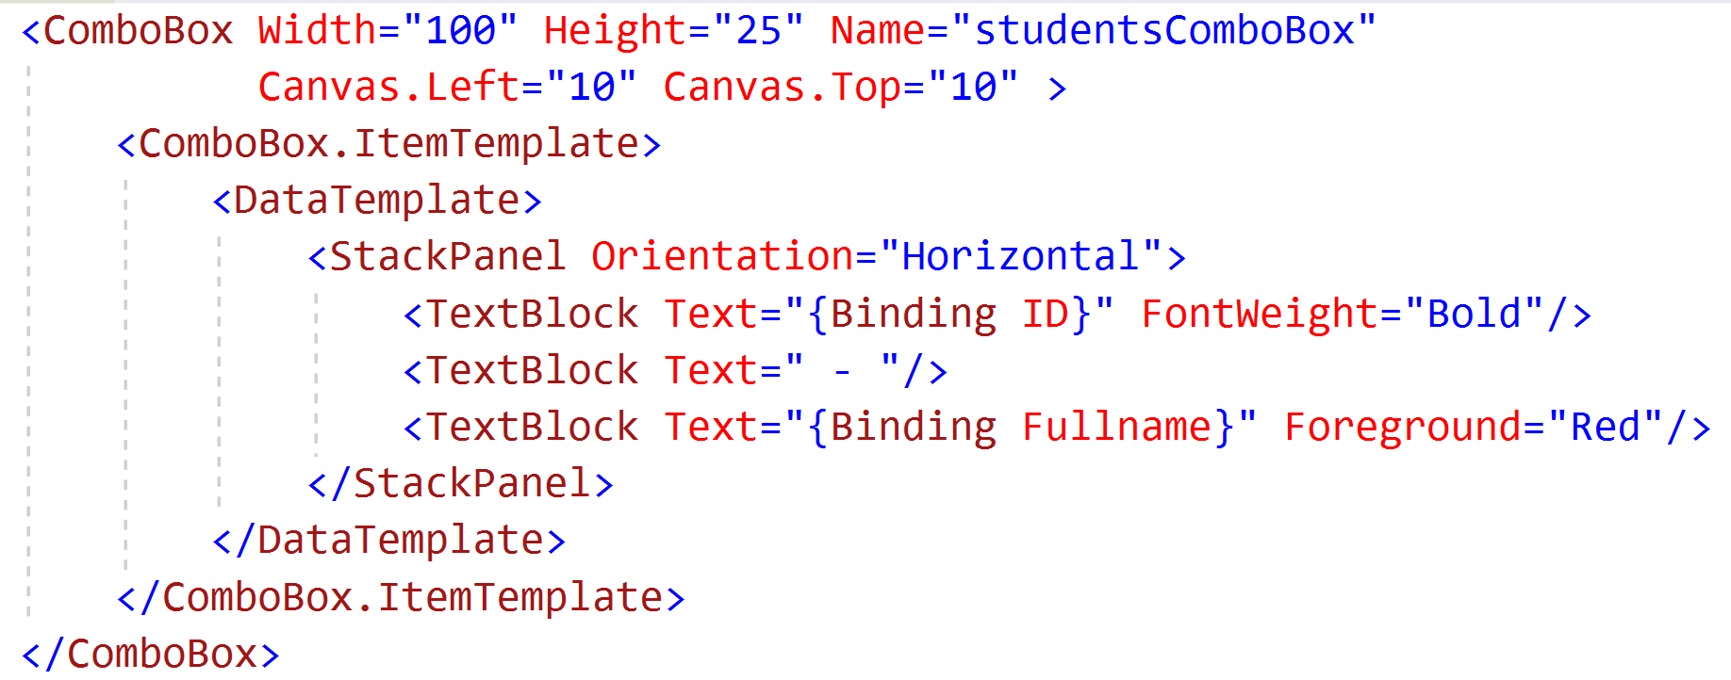
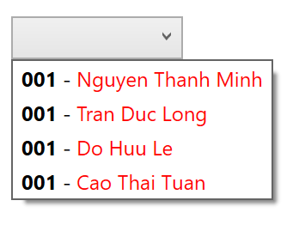
Using ItemTemplate

Slide 32
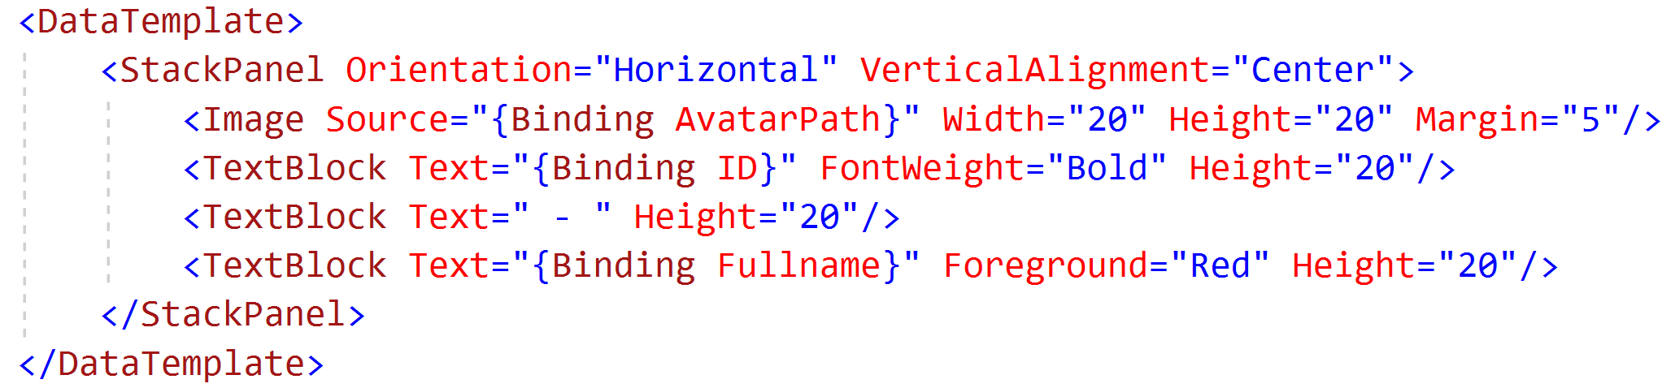
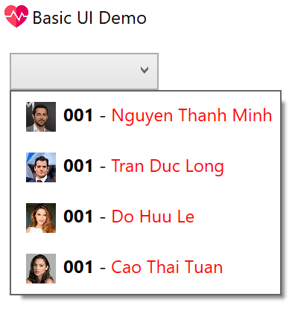
Adding image

Slide 33
Editing the list

Slide 34
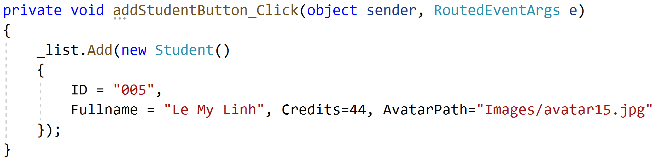
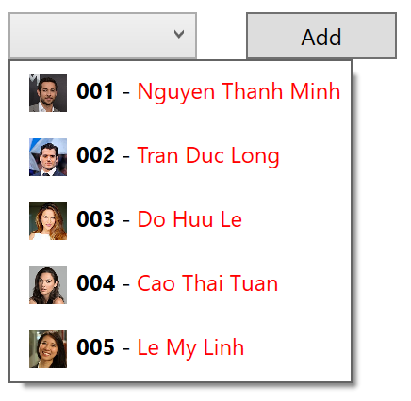
Adding a new item
Convert the list to binding list

Slide 35
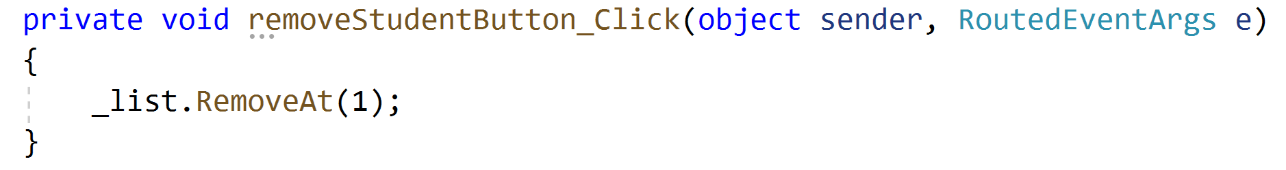
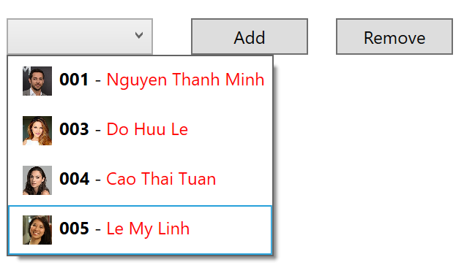
Delete an item

Slide 36
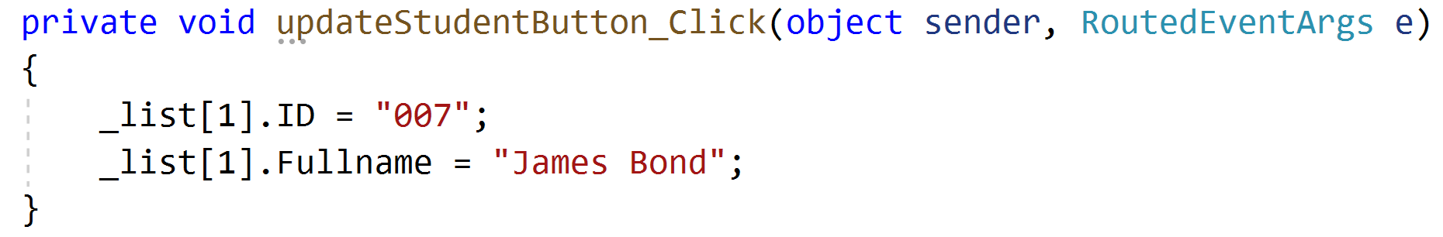
Update an item

Slide 37
Using ListView

Slide 38
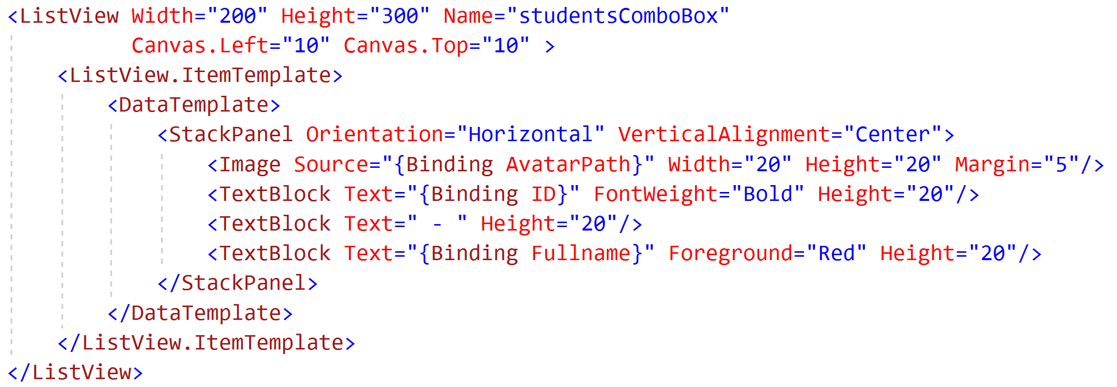
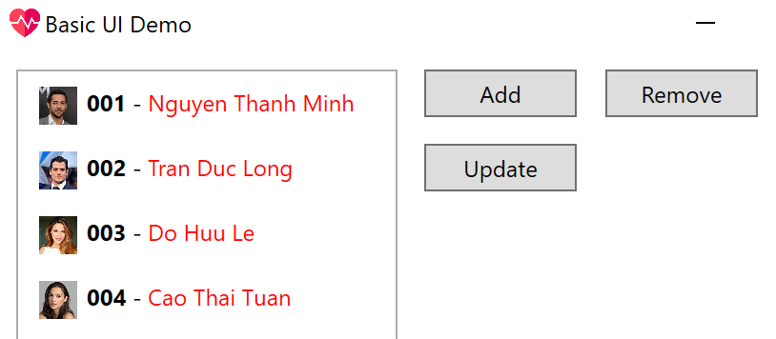
Convert to using ListView

Slide 39
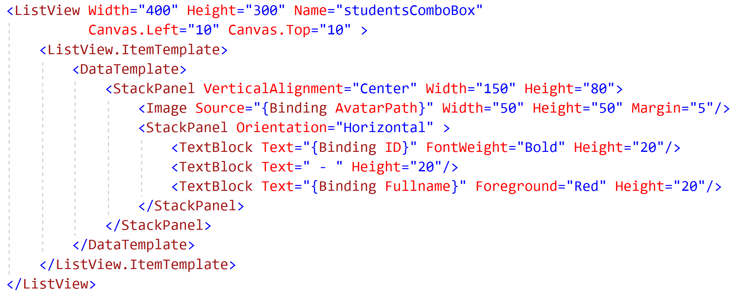
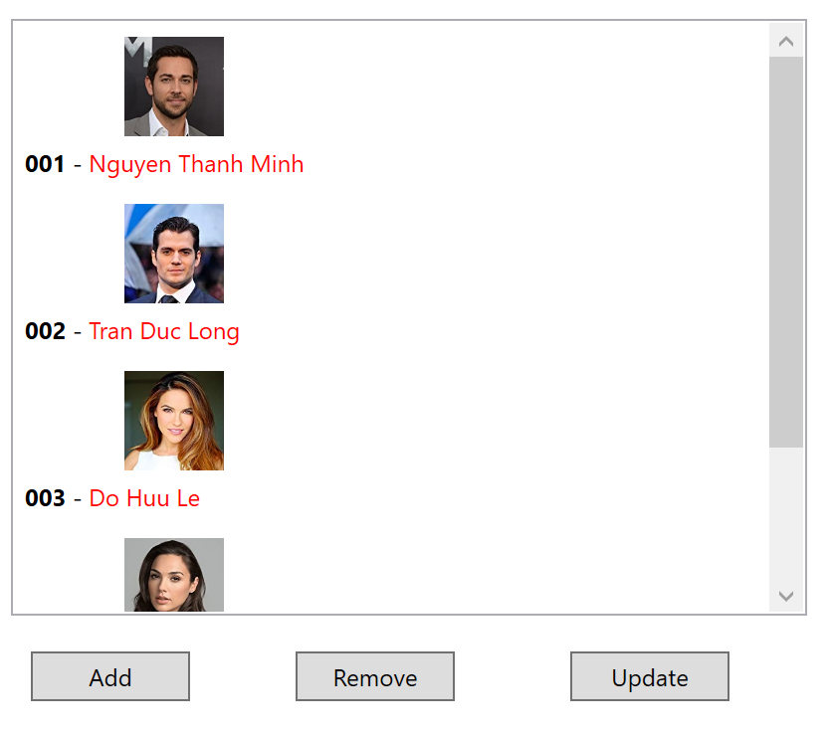
Minor change in displaying

Slide 40
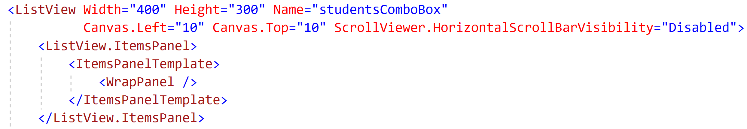
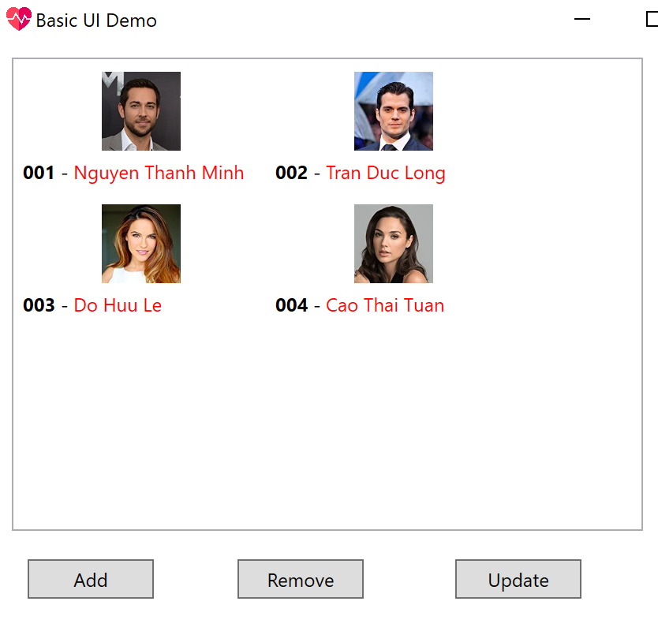
Using WrapPanel

Slide 41
Homework
Do data binding for a list of books: Book’s name, Cover’s image, Author, Published Year
Do data binding for a list of mobile phones: Phone’s name, Image, Manufacturer, Price
Do data binding for a list of employees: Fullname, Email, Address, Telephone number, Avatar’s image
Prepare at least 5 items
Add, Delete, Update (hard code data)

Slide 42
Handling context menu
<ListView.Resources>
<ContextMenu x:Key="TenCuaContextMenu">
<MenuItem Header="Delete" Click="MenuItem_Click"/>
<MenuItem Header="Edit"/>
</ContextMenu>
</ListView.Resources>
<ListView.ItemContainerStyle>
<Style TargetType="{x:Type ListViewItem}" >
<Setter Property="ContextMenu" Value="{StaticResource TenCuaContextMenu}" />
</Style>
</ListView.ItemContainerStyle>

Slide 43
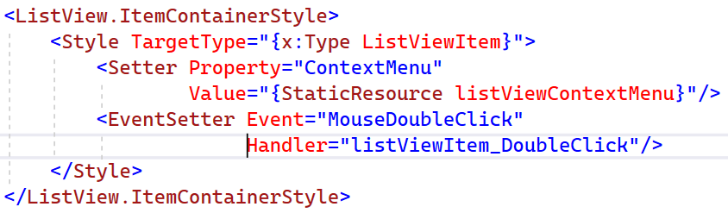
Handling double click
Does not work when clicking on empty space

